Slide 2
Kiota Modern OpenAPI Client Code Generation
Vincent Biret
Darrel Miller

Slide 3
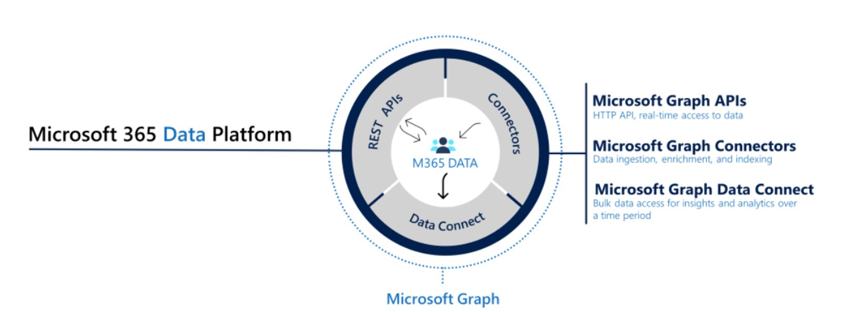
Microsoft Graph

Slide 4
Our challenge
2M Applications calling Microsoft Graph
Only 500K via SDK

Slide 5
Popular reasons not to use an SDK
I don’t need an SDK, I know how to make HTTP calls
aka I don’t want to learn yet another SDK
I don’t want the dependency
aka the SDK has out of date dependencies, or I have to call five APIs, I don’t want to pull in 5 different SDKs
I didn’t know there was an SDK
aka I couldn’t find it after looking for a few minutes
I need high performance, low latency, low footprint
aka your package is huge!
I don’t know why I need it?
aka I may not have handled rate limiting, and expiring tokens
It is poor quality
aka I could build it better myself

Slide 6
What if we stopped shipping client SDKs for APIs?

Slide 7
Self-serve API client code generation has been proven to work for GraphQL, gRPC, and SOAP.
The biggest opportunity for impact is in HTTP APIs.

Slide 8
Why is Kiota different?
A tool for API consumers not API providers.
Includes discovery and selection experience as well as generation
Complete OpenAPI support
It is opinionated about projecting HTTP concepts to the client API surface.
It has enterprise funding, and a growing community

Slide 9
Kiota: API Client Code for API consumers
Application
Code
App Specific Interface
Mocking Interface
Observability Config
Service Adapter
Generated Kiota
API Client Code
Kiota.Abstractions
Kiota.Http.*
Kiota.Serialization.*
Kiota.Authentication.*
OpenAPI
Description
Kiota Discovery
and Selection
Replaceable
Core libraries
Native Libraries
HTTP API Service

Slide 10

Kiota Demo
GitHub and Todo

Slide 11

Feedback
https://aka.ms/get/kiota

Slide 12
Download .NET 8
https://aka.ms/get-dotnet-8

